Slide 1

AI Examiner
Team
Ryan Lim Fang Yung
Lau Zhan Ming
Lee Zhi Yan

Slide 2




Problems
Insufficient Resources
Busy Teacher
Topic Biases
Notes:
Generate extra questions and resources for students to prepare exam themselves, students can also set the difficulty and weak topics themselv, tailor made. Self help for students when met with low qualified teacher.
Busy teachers that want to provide more exercises for students. Also provide teachers a guideline on the format, difficulty and completeness of the question.
Reduced bias on the type of questions produced.

Slide 3


Solution - AI71 generate examples & sample papers
Input
Past papers
Exercises
Database
PDF viewer
JSON/ Dict
AI71
Constraints – Scope
Textbook
HTML
Difficulty
Format
Mutual Feedback
Extract format
Parse prompts
User:
Students/
Teacher
Context: Teacher role

Slide 4
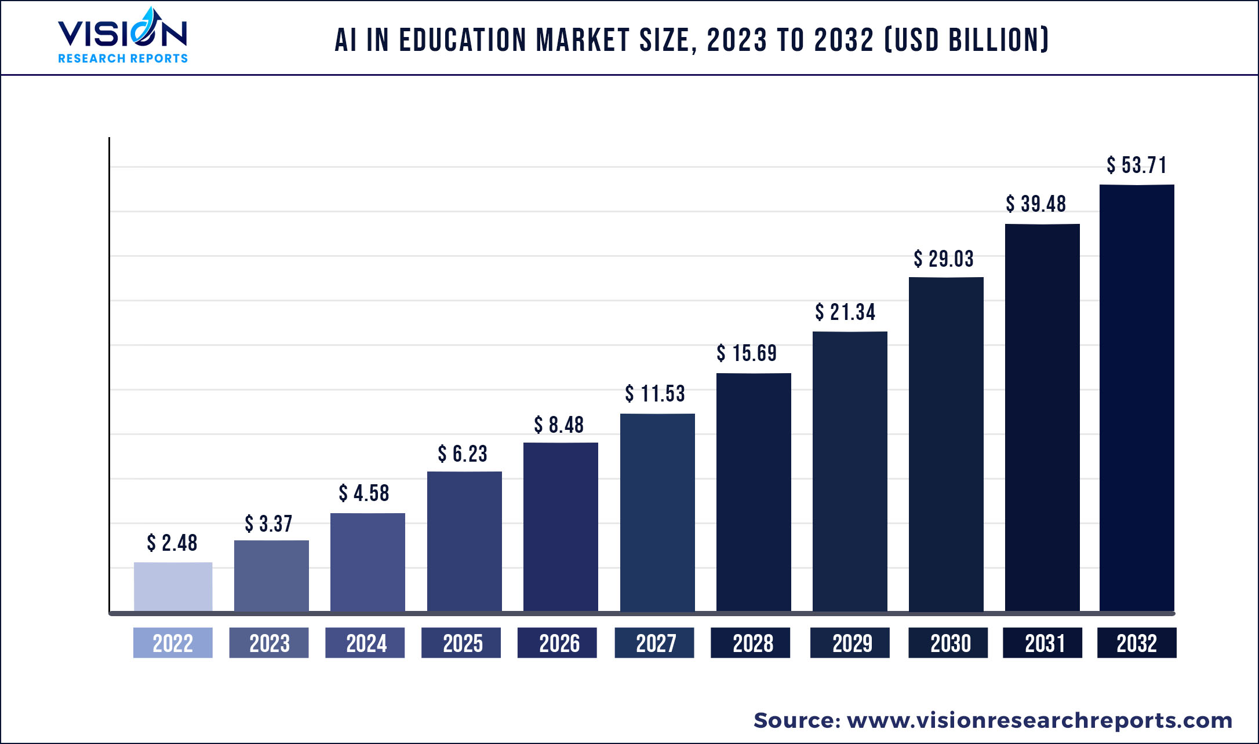
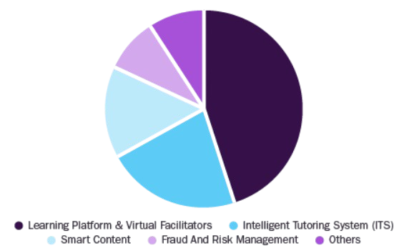
Market Size
Source: https://www.grandviewresearch.com/
Approx 1/5
~ 1B USD market size!

Slide 5



Revenue Stream
Free - 3 generations per day
Subscription - Unlimited
Educational institutes
Publisher
Affiliate marketing – advertising books / educational platform

Slide 6



Next Steps
Personalized adaptive exercise generation
Real time solution feedback
Audio recording for auditory learning preference

Slide 7
Working Demo

